Slide 1


AI-BASED TRAVEL PLANNER
GEN-AI
~JYOTHSNA.P
~YASHWANTH.S
~VARSHAA
~KIRAN.J

Slide 2


OBJECTIVE :
To develop an AI powered travel app that personalise trip planing by generating optimised based user preference, budget and real data time.

Slide 3
NEED FOR THIS PROJECT :
Online Travel Agencies (OTAs): Platforms like MakeMyTrip and Booking.com thrive by helping users compare, customize, and book travel options.
Custom Itinerary Platforms: Services that personalize travel plans based on interests, budgets, and time, often driven by AI-based recommendation engines.
App-Based Planning Tools: Mobile apps offering destination guides, packing lists, route maps, and real-time alerts for weather and traffic. Enterprise and Business Applications

Slide 4
WHY DO WE NEED AN IMPROVEMENT:
1. Personalization Problem: Most travel planners offer generic itineraries. Need: People have different preferences (budget, pace, interests like culture vs. adventure), and a better planner should tailor trips accordingly.
2. Real-Time Information Problem: Delays, weather changes, or closures aren’t reflected in many plans. Need: Improved planners should offer real-time updates and suggestions to adapt on the go.

Slide 5
PROPOSED SOLUTION:
1. AI-Powered Personalized Itinerary Generator What it does: Uses AI to create custom travel plans based on preferences like interests, budget, travel dates, pace, and group size. Benefit: Saves time and offers a unique, relevant experience for each traveler.
2. All-in-One Travel Dashboard What it does: Integrates flights, accommodations, transport, attractions, visas, and even local events in one platform. Benefit: Eliminates the need to juggle multiple apps and simplifies the whole planning process.
3. Real-Time Updates & Smart Notifications What it does: Sends alerts for flight delays, weather changes, traffic, or venue closures, with alternative suggestions. Benefit: Keeps the trip on track with minimal disruption.

Slide 6
MODULES (FRONT-END):
1. Home Page (Landing) Components: Hero section with search bar (destination, date, budget) Features overview (AI planner, real-time updates, eco-travel, etc.) Testimonials / Highlights “Plan Your Trip” CTA button
2. Trip Planner Dashboard [Core Interface for Planning Trips]
a. Sidebar Navigation Trips Itinerary Bookings Map Collaborators Settings
b. Main Panel (Tabs or Sections) ➤ Trip Overview Destination, Dates, Budget Travel preferences (e.g., relaxation, adventure, cultural, etc.) ➤ Itinerary Builder Drag-and-drop daily planner Add/remove activities, meals, transport Timeline view or calendar view ➤ Smart Suggestions Nearby attractions, restaurants, experiences AI-generated recommendations Real-time event feed

Slide 7
MODULES BACK-END:
1. User Management Module Functions: User registration/login (OAuth, email, etc.) Profile management Session/token handling (JWT) User preferences & history
2. Trip Planning Module Functions: Create/edit/save trips Store trip metadata (destination, dates, budget) Itinerary generation (manual + AI-assisted) Track user interests and custom preferences Multi-day itinerary structure support
3. Itinerary & Activity Management Module Functions: CRUD operations on activities (add, update, remove) Day-wise scheduling logic Integration with Google Places/TripAdvisor APIs Time conflict detection Attach media, notes, or location info to activities

Slide 8
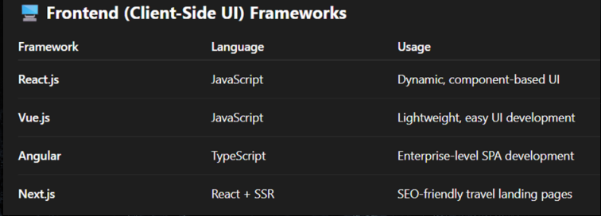
FRAME WORK USED:

Slide 9
BENEFITS AND FURTURE SCOPE:
1. Time-Saving Automates research, itinerary creation, and bookings. Reduces time spent switching between apps (flights, hotels, maps, etc.).
2. Personalization Uses AI to tailor trips to a traveler’s preferences, budget, and interests. Provides recommendations based on user behavior, past trips, or travel trends
. 3. Cost Optimization Finds deals, compares prices, and helps avoid peak travel costs. Suggests budget-friendly alternatives and bundles (flights + hotels + experiences)
4. Real-Time Assistance Notifies users of flight delays, weather issues, or local disruptions. Offers dynamic re-routing or rescheduling based on real-time data.

Slide 10
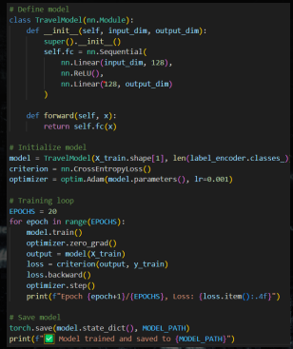
CODE:

Slide 11
THANK YOU
THANK YOU
THANK YOU

